Slide 1

Talkoot*: Discover, Tag, Share, and Reuse Collaborative Science Workflows
*barn raising in Finnish
Rahul Ramachandran, Sunil Movva, Helen Conover
Univ. of Alabama Huntsville
Chris Lynnes, NASA/GSFC
Brian Wilson, NASA/JPL
brian.wilson@jpl.nasa.gov
rramachandran@itsc.uah.edu
Fall AGU 2009
San Francisco, CA

Slide 2
Goal
Exploit collaborative and social (Web 2.0) tools to create “open science” portals where one can tell a science story, and discover, author and share distributed science workflows.
Integration of many ideas:
  eScience On-Line Notebooks
  Social tagging (annotate & share)
  Publish science algorithms as callable Web Services!
  Publish science analysis as re-executable Workflows!
  Semantic (faceted) discovery of workflows and data
  Multiple workflow engines supported (BPEL, SciFlo)
  User-generated content using Drupal CMS

Slide 3
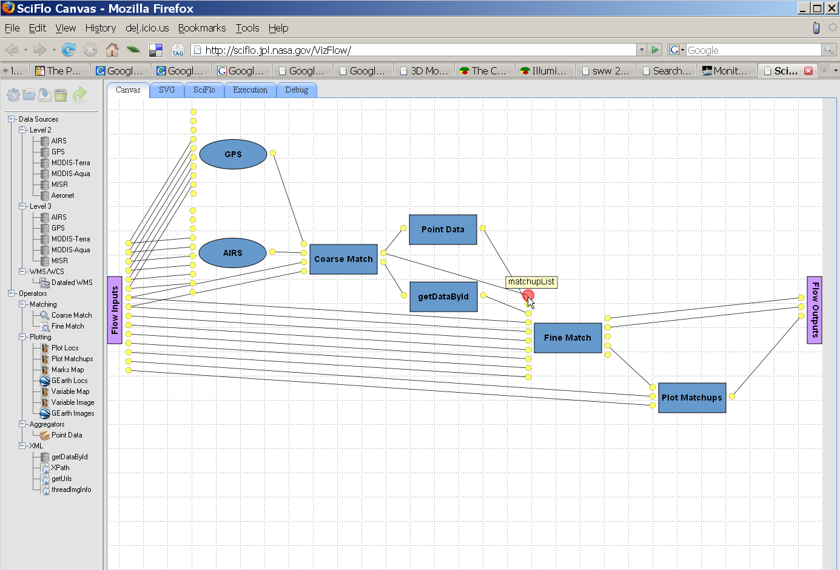
SciFlo Visual Authoring
Assemble workflow using visual layout
Connect a series of services and operators into a dataflow
  Drag services/operators from menu, and drop onto the canvas
  Lay out the flowchart by moving nodes
  Connect the input/output ports by drawing lines
  User guided by matching up port names and types

Slide 4
eScience: Vision vs Reality
Vision: the use of advanced computing technologies to support scientists [De Roure & Hendler, 2004]
Reality: focused primarily on “enabling” use of infrastructure resources
  Data Access
  Computational Issues (Grids, Cloud Computing)
What is missing?
  New Ways of Publishing
  Collaboration!!

Slide 5
eScience Challenges
Format: eJournals, Collaboration Environments, Blogs
  Beyond PDF documents (which mimic paper)
  Hyperlinks, embedded datasets/workflows, fast turnaround
  Science stories with GoogleEarth animations
Sharing
  User & group presence, social tagging, workgroup collaboration
  How much of work product is shared? Preliminary exploration?
Security & Privacy
  Public and private sub-pieces, fine-grained control of permissions
Attribution / Reputation
  Why contribute? Must have citable attribution to build reputation.
Trust
  Retain peer review (stronger than wikipedia)
  But exploit blog formats (micro articles)

Slide 6
“Micro Articles”
Micro Articles (Journal of Earth Science Phenomena)
  Short academic text with figures & references
  Peer reviewed
  Socially tagged, searchable
  Ref: Tero, H., et al., 2008: Tutkimusparvi: the open research swarm in Finland. Proceedings of the 12th international conference on Entertainment and media in the ubiquitous era, ACM.
Benefits
  Offer quick and easy way to test concepts, ideas, research plans
  Share information, data and algorithms
  Cover fast-breaking geophysical events, natural hazards
  Can be found online via all major search engines such as Google
  Are citable
  Speed up the "knowledge" sharing cycle within the science community

Slide 7
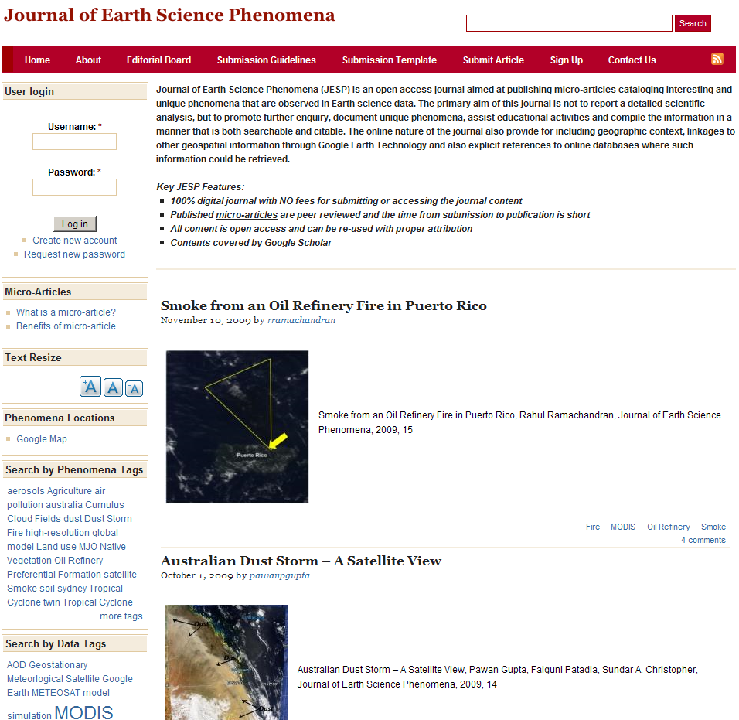
Peer-Reviewed Micro Articles

Slide 8
“Micro Articles”
Micro Articles (Journal of Earth Science Phenomena)
  Short academic text with figures & references
  Peer reviewed
  Socially tagged, searchable
  Ref: Tero, H., et al., 2008: Tutkimusparvi: the open research swarm in Finland. Proceedings of the 12th international conference on Entertainment and media in the ubiquitous era, ACM.
Benefits
  Offer quick and easy way to test concepts, ideas, research plans
  Share information, data and algorithms
  Cover fast-breaking geophysical events, natural hazards
  Can be found online via all major search engines such as Google
  Are citable
  Speed up the "knowledge" sharing cycle within the science community

Slide 9
What’s missing?
A reusable, extensible and customizable environment for building collaborative “open science” portals for managing these shared analysis workflows.
Current collaborative portals have been one-time development efforts for specific science domains that cannot be easily extended beyond their initial features or reused by other science domains

Slide 10
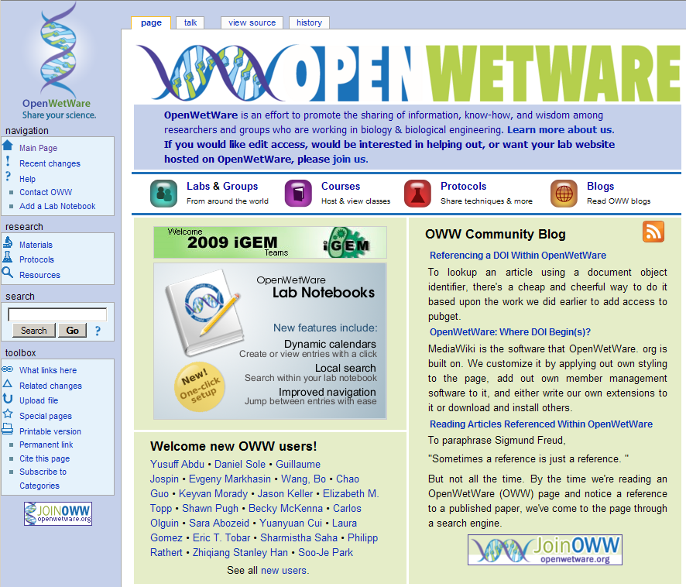
BioMed: Shared Lab Notebook

Slide 11
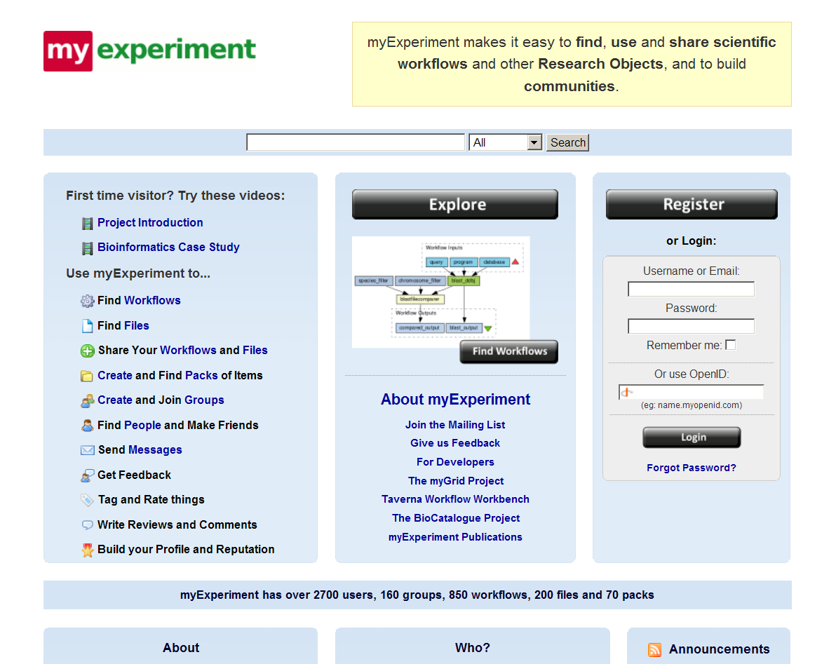
BioMed: myexperiment.org

Slide 12
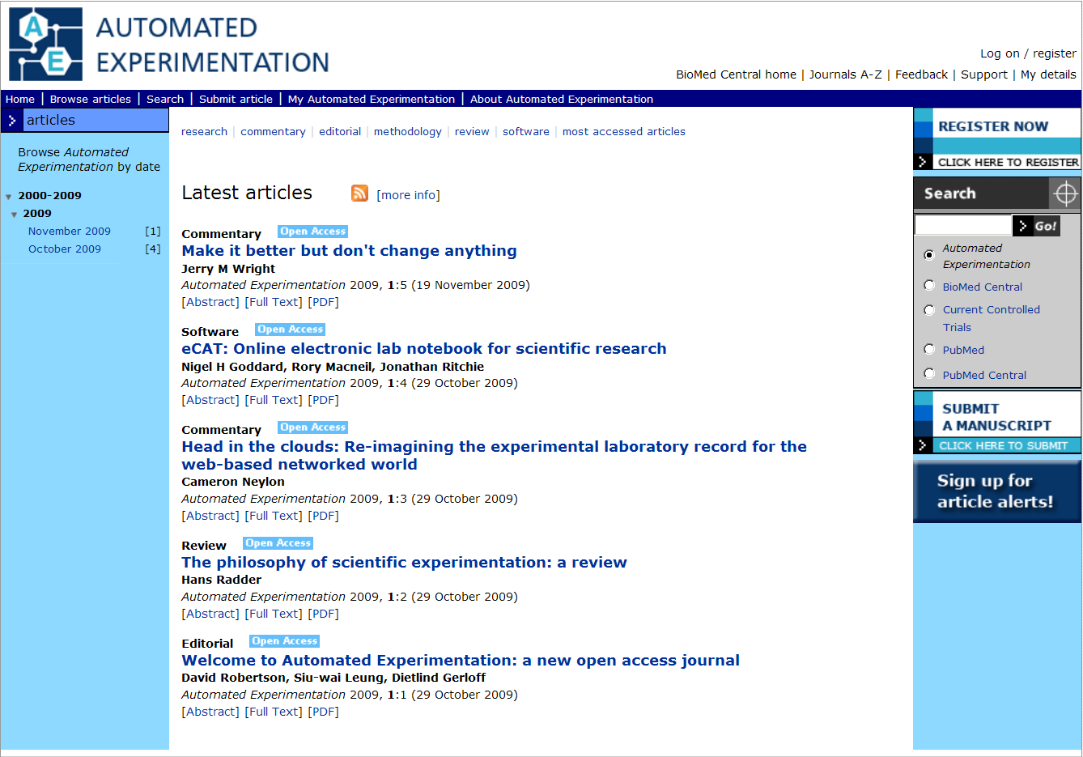
BioMed: Open Access eJournals

Slide 13
Enter Talkoot!
Talkoot is a customizable “software appliance” to build collaborative portals for Earth Science services and analysis workflows.
Talkoot will allow researchers (not just information technologists) be able to build collaborative sites around service workflows within a few hours
Talkoot is leveraging Drupal, an open architecture platform to provide the core Content Management System capabilities required by an online collaborative portal
  Drupal has a vast array of contributed that provide additional features
Talkoot adds Earth Science-specific modules to provide data searching, processing and analysis capabilities.

Slide 14
Features of Drupal CMS
Shared web site with role-based permissions by page
  Collaborative notebook, backed by versioned database
  Hundreds of built-in modules and content types
  Themed sites via style templates (all without code)
User-generated Content Types
  No raw HTML authoring
  Use GUI: Content Construction Kit (CCK)
  Built-ins: stories, books, blogs,
Social Tagging using user-defined hierarchical taxonomies
  Tab-based search, tag cloud,
Blogging for public or groups
  Threaded comments on most content types
Syndication: Interest feeds of new users, tagged pages, etc.
Recommendations, permalinks, and much more . . .

Slide 15
eScience Notebooks
Author shared science notebooks
  Publish a science story with in-line figures, video, KML animations
  Backed by executable workflows that reproduce figures, etc.
  Share publicly or to specific users/groups
Multiple workflow engines embedded (authoring & exec.)
  Mining Workflow Composer: BPEL service orchestration
  SciFlow grid workflow engine: execution at multiple sites
  Visual authoring GUI for both, clone and edit
Tag and Discover stories and workflows
  User-defined hierarchical taxonomies
  Semantic (faceted) search using tags & popularity
  Interest feeds by tag search
Collaboration
  Discover users with common interests, relevant workflows
  Comment on notebooks or write your own blog

Slide 16
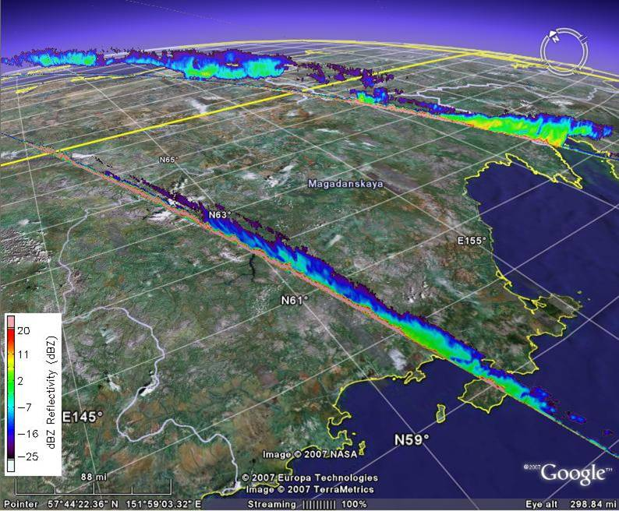
Tell a Science Story with GEarth
Workflow results include science animations as one or more KML files
  Embed GEarth animation in the science notebook

Slide 17
eScience Notebook: Content Types
Content Type | Purpose | Editors / Viewers
Text, HTML, image, link, contact, etc. | Simple content fields | WYSIWYG editors built in to Drupal CMS
Workflow | Author or execute a distributed web services workflow | VizFlow / SciFlo Mining Workflow Composer / Active BPEL engine
Figure | Visible plot or visualization with a caption | Figure view, to be developed
Story | Page with mixed content that can be “commented on” by other users | Basic story/book view is built into CMS, but now extended for science.
GeoLocation Field (geoRSS tags) | Add geolocation information into any content type | GeoLocation views: formatted text or embedded Google Map
KML Placemark | View placemarks or images of data on the globe | Google Maps or Google Earth, embedded in web page or separate viewer window
Event (time/space region or geophysical structure) | Describe hurricane event or periodic structure such as El Nino | Bounding box text viewer or G. Maps; popup link to backing query or mining workflow.

Slide 18
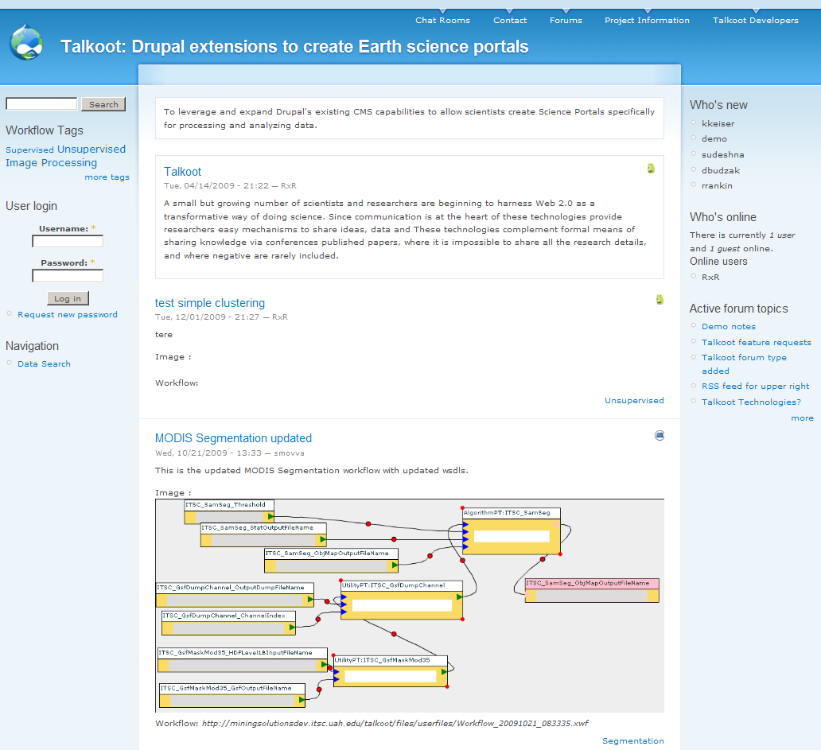
Talkoot: Shared Workflows
User
Presence
Recent
Tags
Forum for
Comments
Embedded
Workflows

Slide 19
Features of Talkoot
Collaboration Site Using Web 2.0 Technologies
  User & group presence, social tagging
  Semantic (faceted) search
  Content Management System (Drupal CMS)
Science Portals using the Talkoot software appliance
  Collaboration site for data search, notebooks, tagging, feeds, etc.
  Embed executable workflows to analyze & create visualizations
  Semantic (taxonomic) search using tags & ontologies
  Feed “casts” of services, workflows, datasets, & events
  Recommendations for useful services, interesting events, etc.
eScience Notebooks
  Tell a science story with pictures, videos, KML movies, links to data
  Discover a workflow, clone it, and modify
  Tag geophysical events, search for relevant datasets
  Create a feed of interesting events and data, publish it

Slide 20
For Beginners and Power Users
Read & comment on science notebooks
  Tag interesting stories
  Find collaborators
Use Workflows
  Discover & execute, examine underlying services
  Clone & edit
  Contribute data query/access services & workflows
Collaborative Authoring
  Comments on stories
  Author notebooks backed by workflows
  Advertise your work via syndication feed or full blog
Organize Group Projects
  Shared notebook for lab group
  Group authoring of science paper, publish after peer review

Slide 21
Talkoot is Extensible
Software appliance (toolkit)
  Goal is hundreds of science (domain) portals
  Focusing on domains will draw users
Drupal base CMS will continue to improve
  More built-in content types, themes, collab. technologies
  More dynamic feel using browser widgets (AJAX)
Community will extend Talkoot for richer eScience
  Add new content types to notebooks using CCK
  Plug in a new module, or extend an existing module
  Add rich visualization tools
  Embed another workflow engine

Slide 22
Summary
Directly Reproducible Science
  Tell A Timely Science Story
  Micro article, with figures & references, backed by an executable data analysis workflow
  Others can build on the workflow or vary the analysis
  Expose work product, but final story still peer reviewed
Talkoot Is A Software Toolkit
  Extend the popular Drupal CMS for Earth Science
  Build many collaboration sites (turn-key solution)
  Community-contributed features to Talkoot / Drupal
Need more eScience Experiments
  More ways of structuring & collaborating on science work
  New ways of publishing with attribution, reputation, & trust

