Slide 1
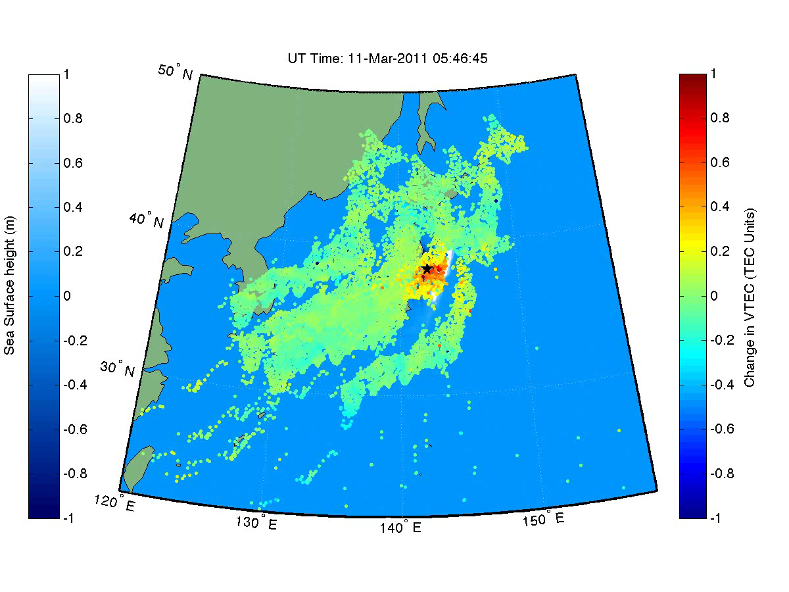
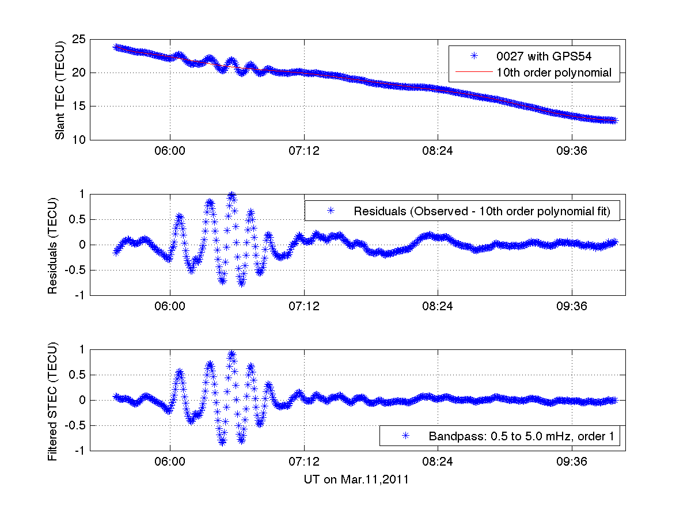
Tohoku Tsunami Seen in Ionosphere Using GPS
Compared with JPL’s Song Tsunami Model
Observations from ~1200 GPS receivers
One of 1200 GPS receiver observations
- Tsunami generates atmospheric gravity waves that propagate to ionosphere.
- Allows imaging of tsunami using GPS Total Electron Content.
Potential application:
- Real-time tsunami monitoring and early warning
Earthquake:
05:46:23 UT
Attila Komjathy (335G), David Galvan (335G), Y. Tony Song (3244), Tony Mannucci (335G)

Slide 2
Tohoku Tsunami Seen in Ionosphere Using GPS
Compared with JPL’s Song Tsunami Model
Observations from ~1200 GPS receivers
Tsunami generates atmospheric gravity waves that propagate to ionosphere.
Allows imaging of tsunami using GPS Total Electron Content (TEC).
Potential application:
-Real-time tsunami monitoring and early warning
Attila Komjathy (335G), David Galvan (335G),
Y. Tony Song (3244), Tony Mannucci (335G)

Slide 3
Tohoku Tsunami Seen in Ionosphere Using GPS
Compared with JPL’s Song Tsunami Model
Gravity Waves
Ocean Tsunami
model
Observations from ~1200 GPS receivers
Gravity Waves
One of 1200 GPS receiver observations
- Tsunami generates atmospheric gravity waves that propagate to ionosphere.
- Allows imaging of tsunami using GPS Total Electron Content.
Potential application:
- Real-time tsunami monitoring and early warning
Earthquake:
05:46:23 UT
Attila Komjathy (335G), David Galvan (335G), Y. Tony Song (3244), Tony Mannucci (335G)

Slide 4
Tohoku Tsunami Seen in Ionosphere Using GPS
Compared with JPL’s Song Tsunami Model
Gravity Waves
Ocean Tsunami
model
Gravity Waves
Observations from ~1200 GPS receivers
Tsunami generates atmospheric gravity waves that propagate to ionosphere.
Allows imaging of tsunami using GPS Total Electron Content (TEC).
Potential application:
-Real-time tsunami monitoring and early warning
Attila Komjathy (335G), David Galvan (335G),
Y. Tony Song (3244), Tony Mannucci (335G)

